Slide 1
Lesson 13: Advanced Object Oriented Programming
This lesson is oriented towards advanced concepts
Ben Schwarz

Slide 2
Intro
Covering several concepts which you should know as well as some advanced techniques and tricks to use.

Slide 3
Scope
Important but I have held off until now since you understand OOP
Scope is what parts of your program can see other parts of the program.
Variables in a function can only be seen by other code in the function. These are known as method local variables.
Variables in a class, known as fields, can be seen by anything in the class.

Slide 4
Modifiers
Modifiers change how variables, functions and classes behave
Aside from the final modifier, all modifiers can only be put on variables declared at the class level, not at the function level
Name | What it does
Public | Makes it visible to all other parts of the program. (Expands its scope)
Private | Makes it visible to only the class it’s declared in (internal to the current file)
Protected | Makes it visible to only itself, things in the same package, and subclasses
Static | Makes it the same throughout every instance of the class – it is not specific to a certain object. If changed it affects all objects of it’s type. For e.g. if you wanted all chair objects to know how many chairs there are you could have a static integer and add 1 to it every time a chair is created.
Final | Makes the variable unable to change - also makes it more efficient, and the code run faster.
final at first seems a bit silly. However, it can be very useful to manage magic numbers - magic numbers are random constants that otherwise get spread throughout your code. Lets say you really like the number 8, and times all the numbers you use in code by 8. All is good, until you decide you hate the number 8 and actually like 4. Now you need to go through and change all 8s to 4s... oh dear that sounds super painful. A better solution would be to have a final variable at the beginning of your file, that everything uses, making everything nice and easy to change frequently. (an IRL (and sane) example is motor ports on the robot - these are all kept as final variables on the robot.)

Slide 5
Default Access
If you don’t place any modifiers then something is given default access.
This means that fields with default access can only be referenced in the same package.
Not even by a subclass of a class containing a field.
A class’s fields and methods are called methods of a class. The rules for access – default and otherwise – apply to all members of classes.
Remember that a method-local variable can only accessed inside a method.

Slide 6
This
The keyword this was touched on earlier but here is another slightly more in depth explanation.
Compare the word to the English phrase “state your name”
I, (state your name) do solemnly swear, to uphold the constitution of the Philadelphia Central High School Photography Society…
The phrase “state your name” is a placeholder. A space in which each person puts their name. E.g. I Bobby Tales, do solemnly swear…
Think of the pledge as a piece of code in a java class. Whenever an instance of the class (a person) executes the code (takes the pledge) the instance fills their own name (that is the object they are) in place of the phrase.
This is very helpful

Slide 7
Exercises
We have some more stuff to cover but since we have already covered a lot here are some activities:
Create a static field inside the parent animal class you made last lesson, and do something with it
Create a program that constructs a Team Object that holds five Basketball Player objects, with each player having different attributes based on their court position. Use a static class field to track the amount of players that have been created, and give the Basketball Player class multiple constructors and methods that do helpful things.
Create an Employee class that tracks how much any single employee should be paid based on their job status. It should also have methods that can helpfully calculate then print this out for you to see.
From this, create two subclasses, one for a full-time employee, and one for a part-time employee.
(I should be able to set and get the salary, benefits deductions, and pay amount, of the employees, through various methods. I should also be able to set the amount of hours a part time employee works in order to dictate how much they are paid. To practise modifiers these amounts should be obtained and changed inside the class with functions and the fields should be private. These functions should be called in another class when you want to reference these fields) Then, document all these classes with comments

Slide 8
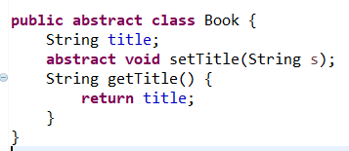
Abstract Keyword and Abstract Classes
The Abstract keyword can be used on both classes and methods.
An abstract class can not be instantiated. You can’t create objects of the class.
These classes only exist to create subclasses.
An abstract method has no body. It’s declaration is finished with a semi-colon. Abstract methods must be in abstract classes.
Example of Abstract Class:

Slide 9
Interfaces
You may have noticed that in java you never get a class to extend more than one parent class.
A class can only have one parent class.
This is fine if you want to your class to be like a frame (window). However, what if you want your new class to be a frame and a button-clicking thing? Can you have your new class be like both?
Yes it can. Java has something called an interface.

Slide 10
What is an interface?
An interface is like a class, but it’s different. (So what else is new? A cow is like a planet, but it’s different)
Anyway, when you think of an interface, start by thinking of a class. Then, in your head note the following things:
A class can extend only one parent class, but a class can implement more than one interface.
An interface’s methods have no bodies of their own. When you implement an interface, you provide bodies for all the interface’s methods. When you announce you’re going to implement an interface, the Java compiler will take this seriously and any methods you fail to give meaning to will create an error.
To signal an interface method’s implementation you can also use @override

Slide 11
So when do we use this?
Well it is used in Arachne (our custom library for coding the robot) in examples such as GettableBoolean, GettableNumber and ListLogic.
Another great example is in Swing (a GUI library that is in the javaAPI) This example I listed earlier but what it means is that in your code you can have your window onscreen be a subclass of a window while implementing a interface to look for things such as button-clicks. (There is a lot more to it and far more behind the scenes which I won’t teach now but if you are interested feel free to research later).

Slide 12
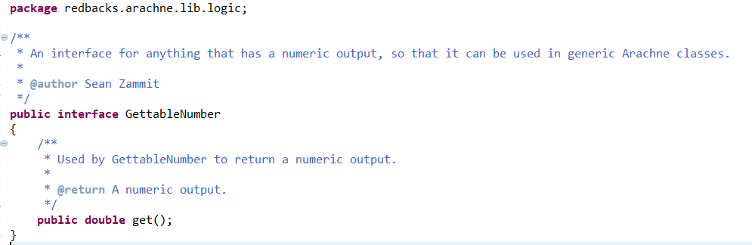
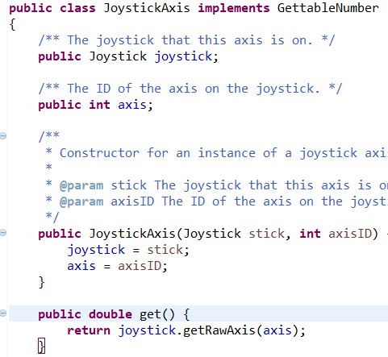
Let us look at gettableNumber
We can see where the interface is created and we can see how it is used in JoystickAxis.

Slide 13
Difference between Abstract Classes and Interfaces
An Interface is a way to let classes have a consistent set of methods.
An Abstract class is a way to group classes into one family.
Abstract class and any children are part of the class hierarchy.
Interfaces are not part of the class hierarchy. (interfaces can have relationship with other interfaces)
A class may be a child of only 1 abstract class. But a class can implement from multiple interfaces
Their only similarity, is that both require the child class to have the methods implemented.

Slide 14
Inner Classes
Did you know you can define a class inside another class!
These are known as innerclasses
Within an innerclass you can refer to an enclosing class’s fields

Slide 15
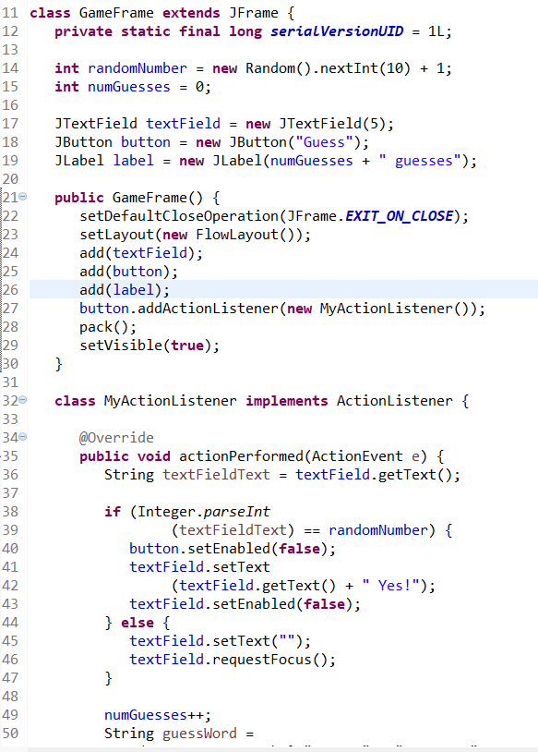
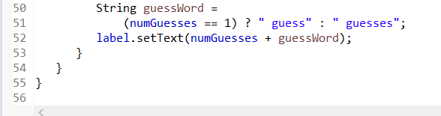
Example of Inner Classes
This code was taken for Java for Dummies 6th Edition

Slide 16
Anonymous Inner Classes
Notice that the previous slide only uses MyActionListener once.
Well do you really need a name for something that is used only once?
No, you don’t. You can substitute the entire definition of the inner class inside the call to creating the object.
When you do this you create an anonymous inner class

Slide 17
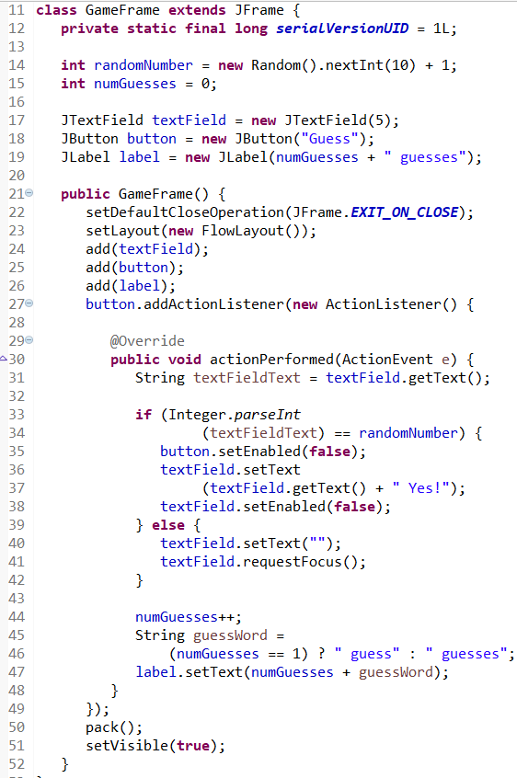
Example Anonymous Inner-Class
You may not see this too often. However, it is good
to remember how it works.
This code was taken from Java for Dummies 6th Edition

Slide 18
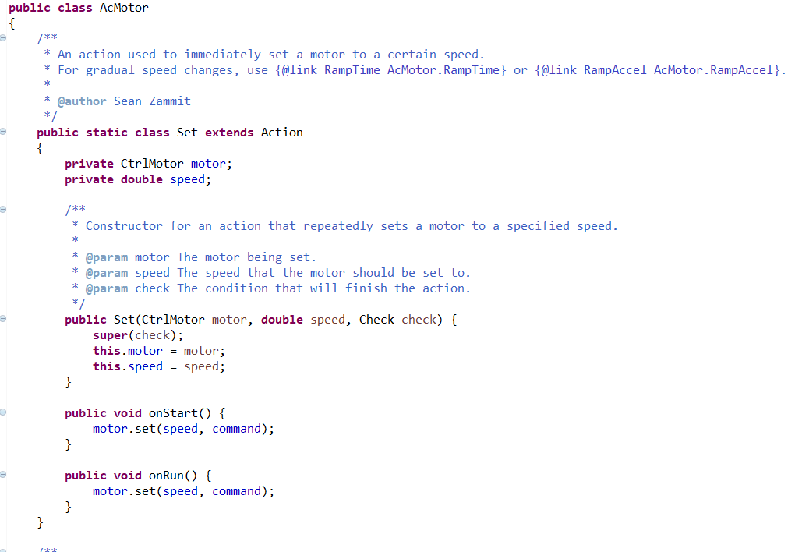
Lets look at an example

Slide 19
Activities:
Make an abstract class called 2d shape. In it define the amount of sides of the shape.
Make a child class called circle, and define what it means to be a circle. From this, add methods that allow you to automatically find things out about your circle object such as its area and circumference
Make an interface called ColouredShape. Have methods for changing the colour.
Make a subclass which consists of coloured circles. Let it implement the ColouredShape interface. Inherit the previous methods.
We have plenty more concepts left to cover but these are important to remember so make sure to do as much practise as you can before moving on.

